Slide 1
TEAM
7
Moving Beyond Linearity
Matthew Esporrin
Brittany Hayes
Verghese Polakunnil
Lisha Shangguan

Slide 2
TEAM
7
Chapter 7
Today:
Polynomial Regression
Step Functions
Later This Week:
Regression Splines
Smoothing Splines
Local Regression
Generalized Additive Models (GAMs)

Slide 3
TEAM
7
Agenda Today
Lab
Step
Functions
Polynomial
Regression
Basis
Functions
Conclusions
Lab

Slide 4
TEAM
7
POLYNOMIAL REGRESSION

Slide 5
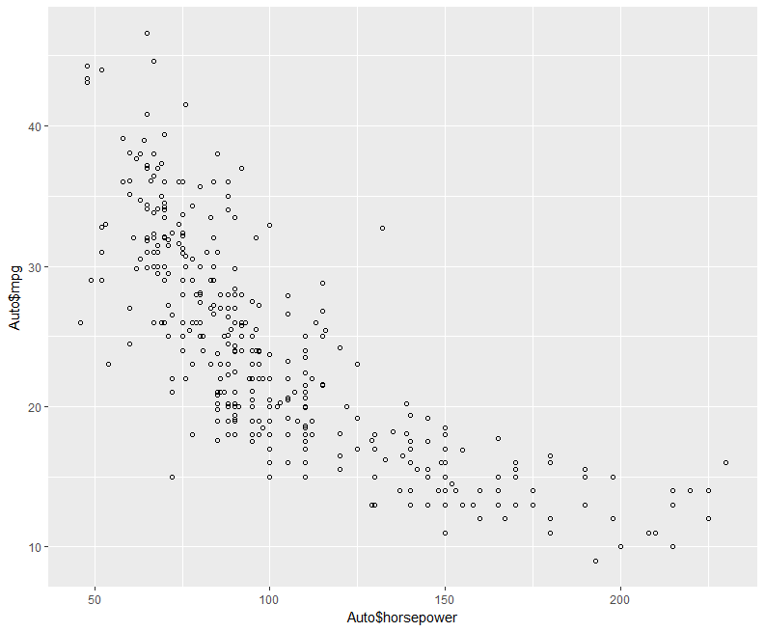
Flashback: Auto dataset
Page
1
Miles per gallon
Horsepower

Slide 6
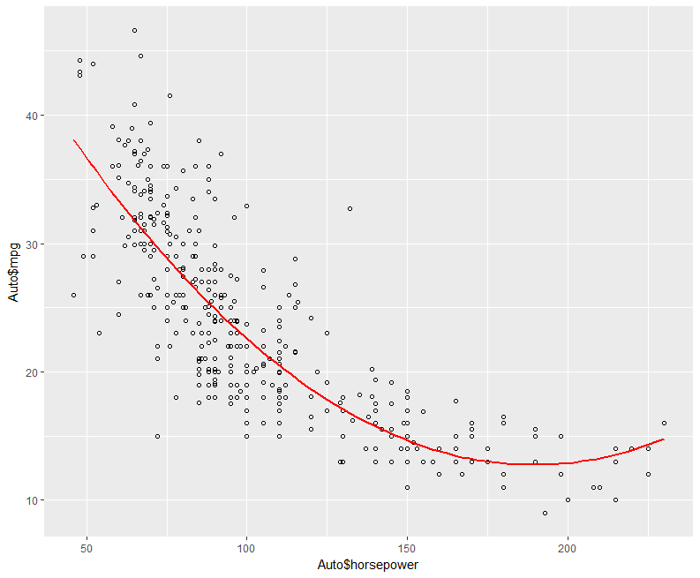
Page
2
Degree 2
Miles per gallon
Horsepower

Slide 7

Page
3
Big idea: extend the linear model by adding extra predictors that are powers of X
Notes:
Employed when the relationship between predictors and response are non-linear

Slide 8
Page
4
Big idea: extend the linear model by adding extra predictors that are powers of X
Note: this is still a linear model!
(and so we can find its coefficients using the least squares approach)
X_{i1}
X_{i2}
X_{i3}
X_{id}
Notes:
Employed when the relationship between predictors and response are non-linear

Slide 9


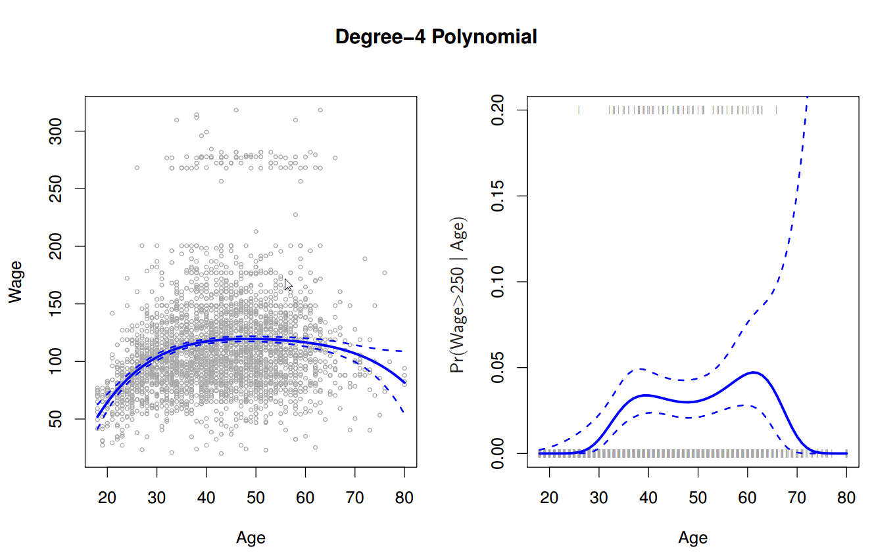
Page
5
Example

Slide 10
Page
5
Example
95% confidence
interval
(i.e. 2x std. error)

Slide 11
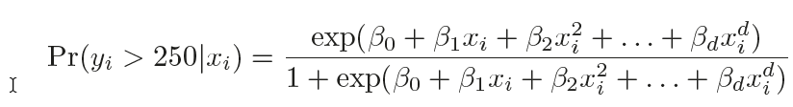
Page
6
Example

Slide 12
Page
7
Example

Slide 13
Page
8
Example
What’s going
on here?

Slide 14

Page
9
What will happen if the degree of polynomial increases?

Slide 15
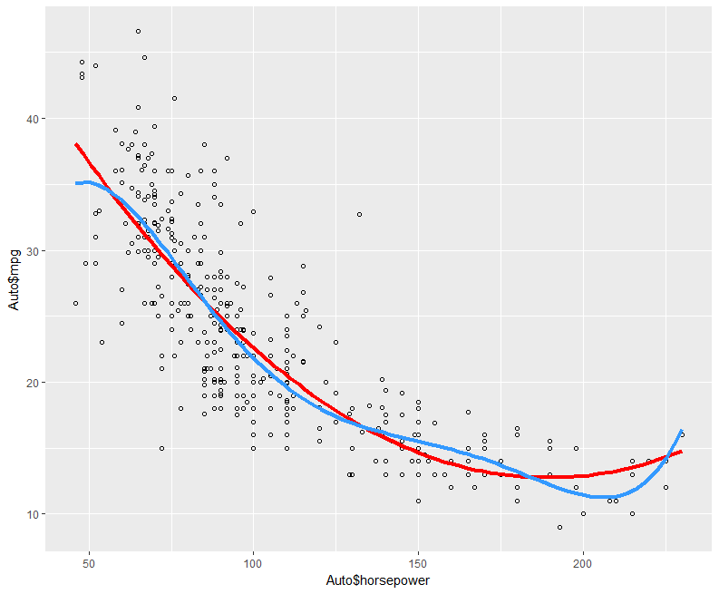
Page
10
Findings
Overly flexible
Strange shape
Degree 2
Degree 5
Miles per gallon
Horsepower
Notes:
Over-fitting happens when your model is picking up the noise instead of the signal: even though your model is getting better and better at fitting the existing data, this can be bad when you are trying to predict new data and lead to misleading results.

Slide 16
Pros and Cons:
Page
11
Pros
A simple form
Moderate flexibility of shapes
Computationally easy to use
Cons
An approach to predict a response Y on the basis of a single predictor X
Impose a global structure on the non-linear function of X
Notes:
Polynomials may provide good fits within the range of data, but they will frequently deteriorate rapidly outside the range of the data.
In order to model data with a complicated structure, the degree of the model must be high, indicating and the associated number of parameters to be estimated will also be high. This can result in highly unstable models.
We can do separately on several variables. Just stack the variables into one matrix and separate out the pieces afterwards (see GAMs later)

Slide 17
TEAM
7
LAB 1

Slide 18
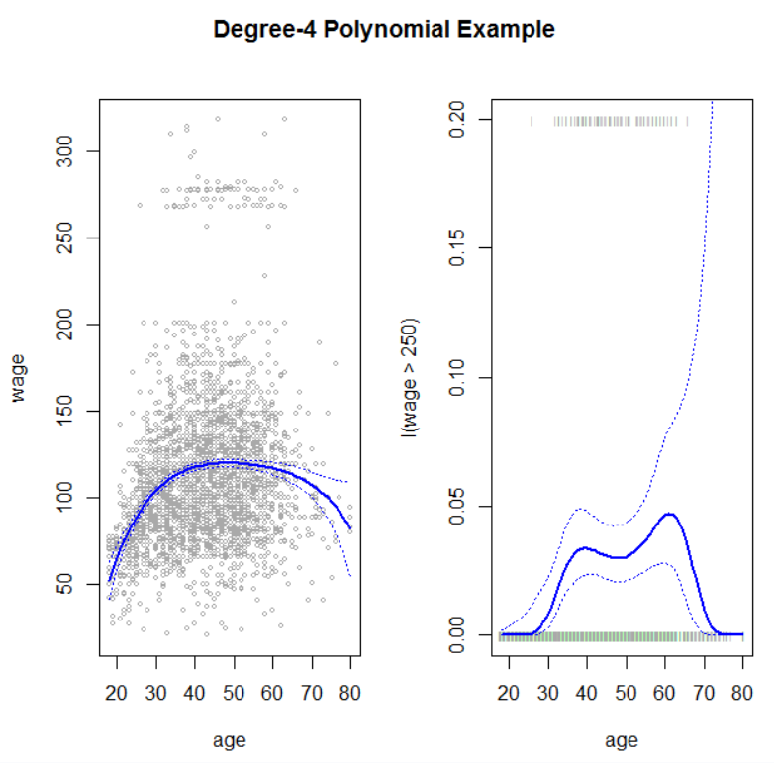
Brief Example of Polynomial Regression
Page
12

Slide 19
TEAM
7
STEP FUNCTIONS

Slide 20
Page
13
Big idea: Break our X values into bins by creating cutpoints in the X range

Slide 21
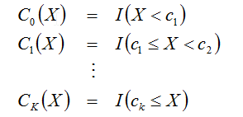
Page
14
Create cutpoints c₁, c₂, . . . , c_{K} in our X range
Construct k+1 dummy variables
I() is an indicator function, which returns either 1 or 0
X can only be in exactly one of the k+1 intervals
Notes:
Often the cutpoints are chosen at natural breaks, such as 5 year intervals.
We convert a continuous variable into an ordered categorical variable.

Slide 22

Page
15
Fit a linear model using least squares
This predicts β₀ + β_{j} for X values in bin j
β_{j} is the average increase in the response relative to the mean value of Y when X < c₁

Slide 23
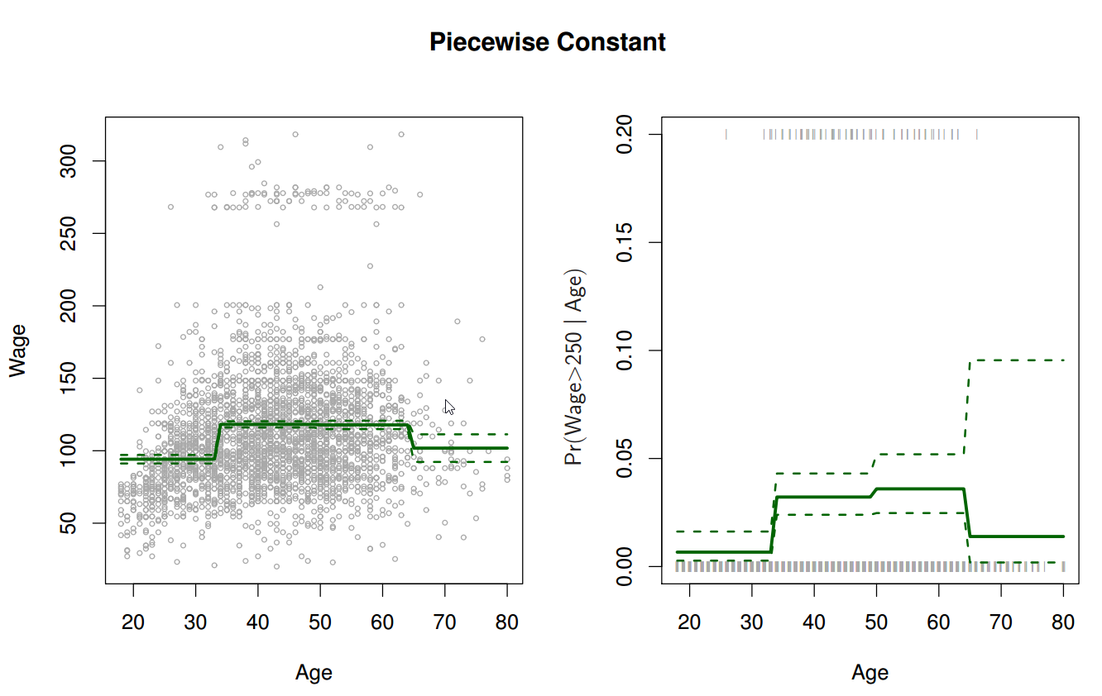
Page
16
Cuts are usually made at natural breaks in the data, such as age intervals
Here the cuts are at 33, 49, and 65

Slide 24
Page
17

Slide 25
Page
18
Bias vs. Flexibility

Slide 26
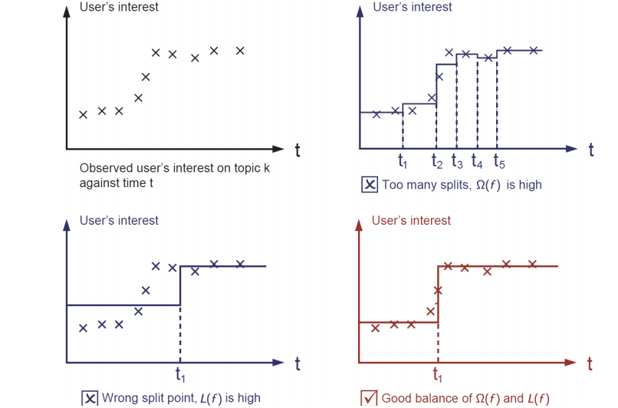
Page
19

Slide 27
Page
19
A.
B.
C.

Slide 28
Page
19
X

Slide 29
Pros and Cons:
Page
20
Pros
Avoids imposing a global structure on the non-linear function of X
Good method of prediction for data with natural breaks
Cons
Can miss trends in the data entirely
Only uses one predictor

Slide 30
TEAM
7
LAB 2

Slide 31
Functions
Page
21
cut(x, breaks)
- Divide the range of x into intervals and codes the values in x according to which interval they fall.
- The leftmost interval corresponds to level one, the next leftmost to level two and so on.
Notes:
Real world examples:
Biostatistics, epidemiology, often to used as a simplification

Slide 32
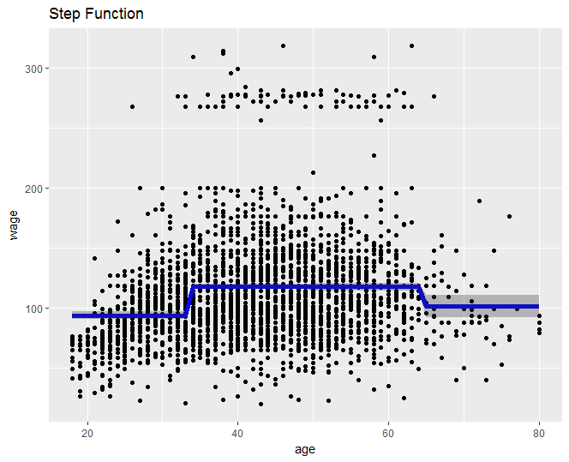
Page
22
Use step functions with the Wage data set
Notes:
Real world examples:
Biostatistics, epidemiology, often to used as a simplification

Slide 33
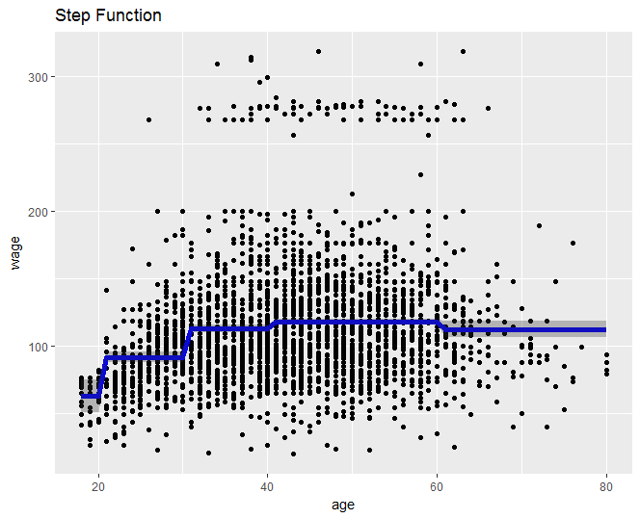
Page
23
Notes:
Real world examples:
Biostatistics, epidemiology, often to used as a simplification

Slide 34
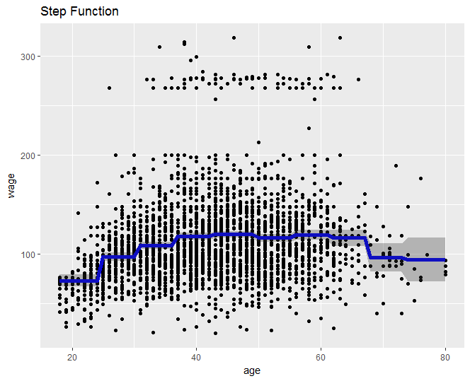
Page
24
Notes:
Real world examples:
Biostatistics, epidemiology, often to used as a simplification

Slide 35
TEAM
7
BASIS FUNCTIONS

Slide 36
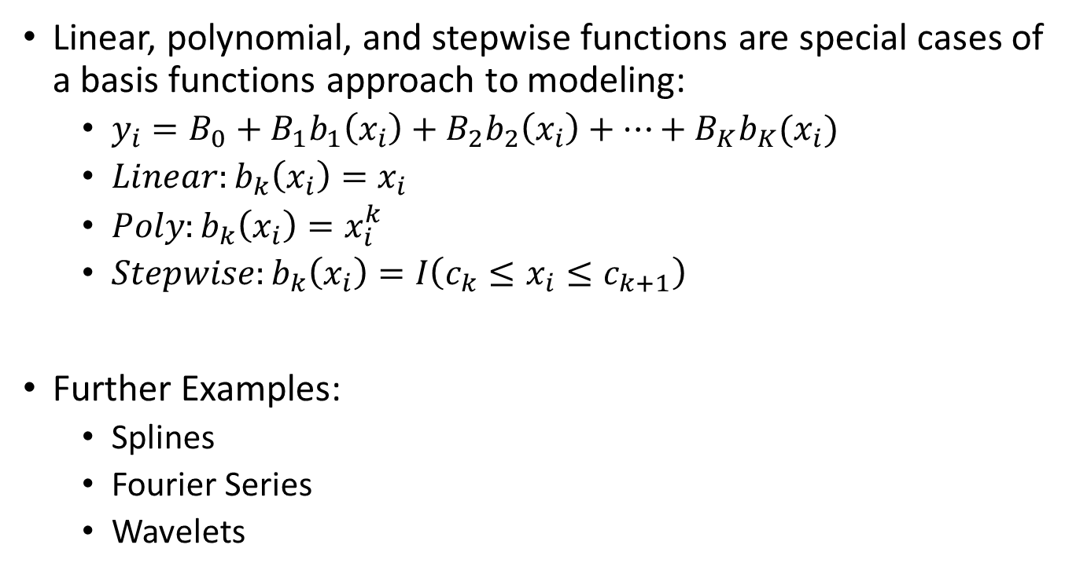
Page
25
Linear, polynomial, and stepwise functions are special cases of a basis functions approach to modeling:
$y_{i}=B_{0}+B_{1}b_{1}\left(x_{i}\right)+B_{2}b_{2}\left(x_{i}\right)+…+B_{K}b_{K}(x_{i})$
${Linear:b}_{k}\left(x_{i}\right)=x_{i}$
$Poly:b_{k}\left(x_{i}\right)=x_{i}^{k}$
$Stepwise:b_{k}\left(x_{i}\right)=I\left(c_{k}≤x_{i}≤c_{k+1}\right)$
Further Examples:
Splines
Fourier Series
Wavelets
Notes:
Comment about linearity of Betas and how b_k revers to different polynomials

Slide 37
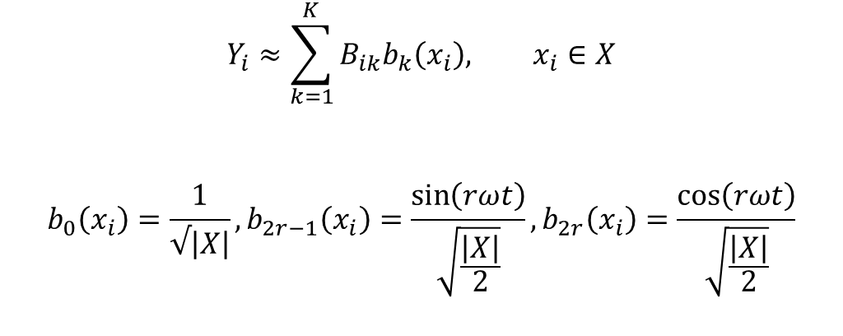
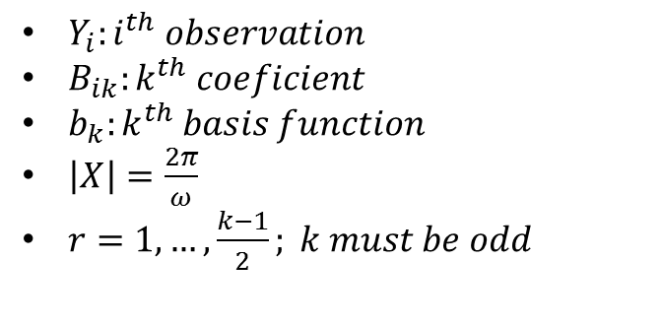
Fourier Series
Page
26
$$Y_{i}≈\sum_{k=1}^{K}{B_{ik}b_{k}\left(x_{i}\right), x_{i}∈X}$$
$$b_{0}\left(x_{i}\right)=\frac{1}{√\left|X\right|}, b_{2r−1}\left(x_{i}\right)=\frac{\sin\left(rωt\right)}{\sqrt{\frac{\left|X\right|}{2}}},b_{2r}\left(x_{i}\right)=\frac{\cos\left(rωt\right)}{\sqrt{\frac{\left|X\right|}{2}}}$$
$Y_{i}:i^{th} observation$
$B_{ik}:k^{th} coeficient$
$b_{k}:k^{th} basis function$
$\left|X\right|=\frac{2π}{ω}$
$r=1, …,\frac{k−1}{2}; k must be odd$

Slide 38
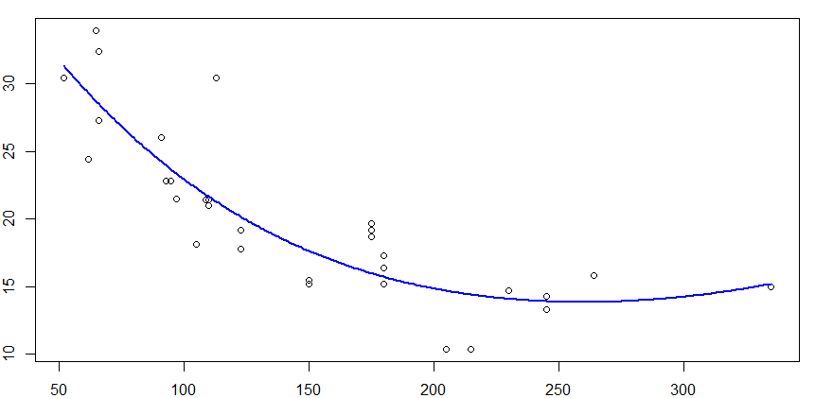

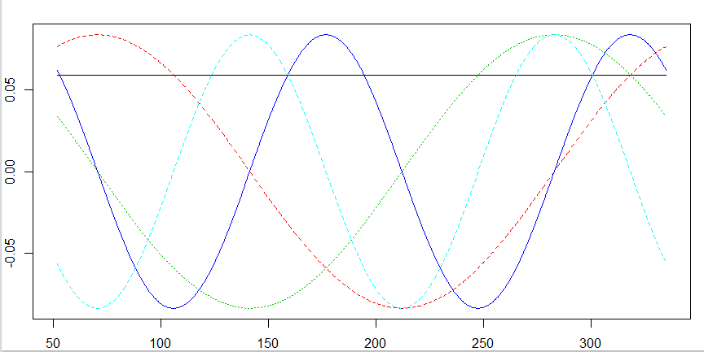
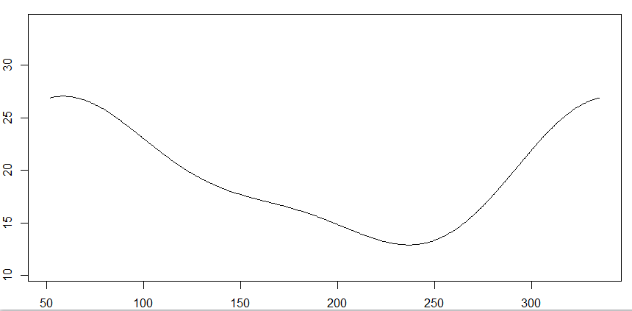
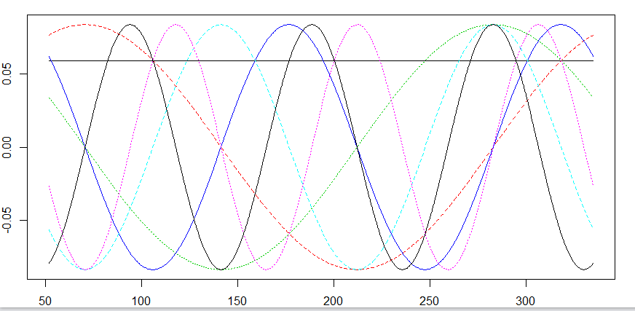
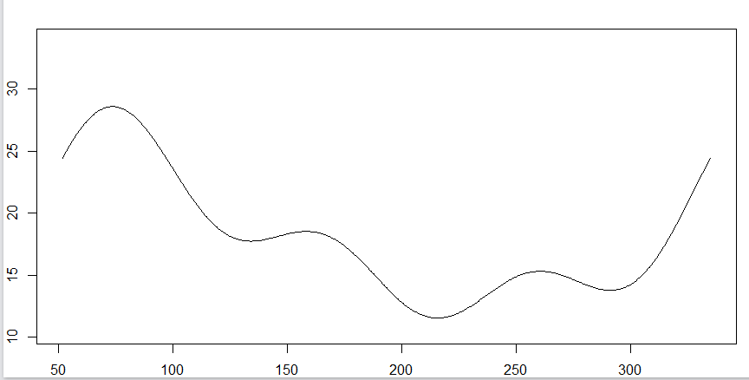
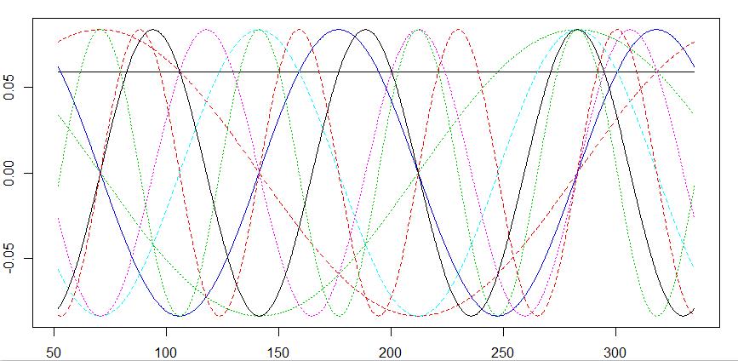
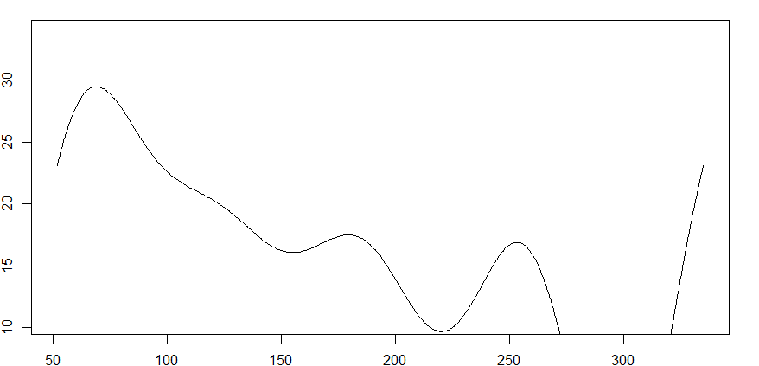
Fourier Basis Functions
Page
27

Slide 39
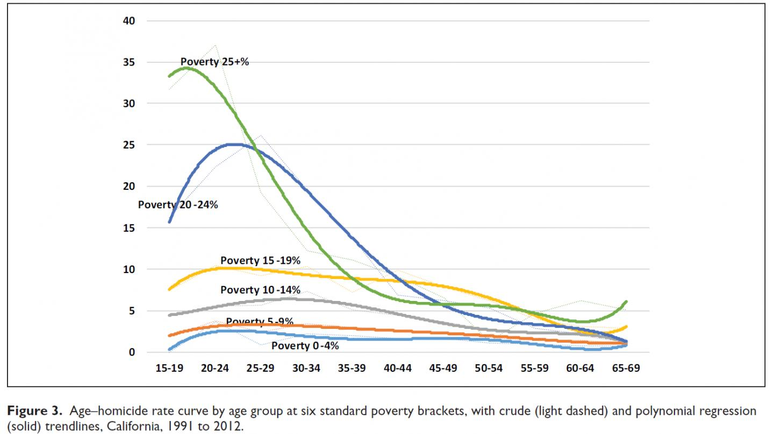
Examples in Industry
Page
28
High teen crime rates thought to be a result of immaturity of teen brain
Study shows that teens have a three times higher poverty rate than adults and crime rates for teens are comparable to crime rates for adults in similar poverty rates
Notes:
https://www.tradingfloor.com/posts/container-rates-and-global-trade-stuck-in-rough-seas-8081571
https://phys.org/news/2016-01-white-storks-migration-patterns-due.html
https://www.eurekalert.org/pub_releases/2015-03/sp-pnt030315.php

Slide 40

Examples in Industry
Page
29

Slide 41
TEAM
7
CONCLUSIONS

Slide 42

Page
30
Polynomial Regression
Mind the degree of the polynomial. Do not use large d (> 4) unless we have additional knowledge that more will help.
Step Functions
Can be useful if natural breaks exist in the data
Basis Functions
Two-dimension only. If we need to consider more variables, other models should be considered. (e.g. GAMs)
Notes:
we generally only go to degree 3 or 4 unless we have additional knowledge that more will help

Slide 43
TEAM
7
Q&A
Thank you!

Slide 44
References
Some of the figures in this presentation are taken from "An Introduction to Statistical Learning, with applications in R" (Springer, 2013) with permission from the authors: G. James, D. Witten, T. Hastie and R. Tibshirani
http://www.science.smith.edu/~jcrouser/SDS293/labs/lab12.html
https://www.tradingfloor.com/posts/container-rates-and-global-trade-stuck-in-rough-seas-8081571
https://phys.org/news/2016-01-white-storks-migration-patterns-due.html
https://www.eurekalert.org/pub_releases/2015-03/sp-pnt030315.php

